Slide 1
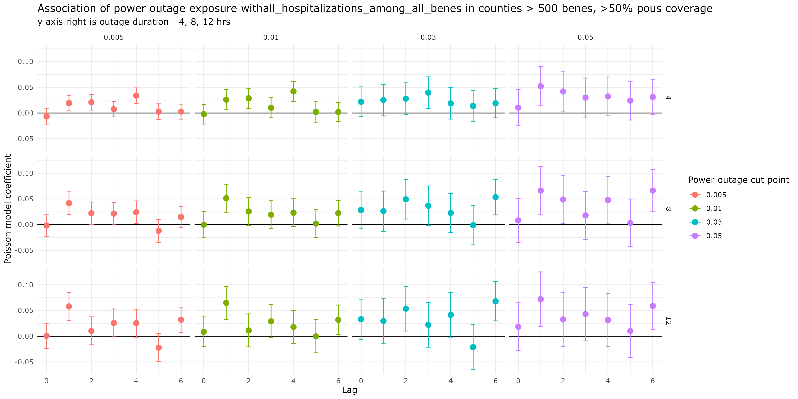
Main analysis – all hospitalizations for resp and cvd, no hem no hypertension, with sensitivity across cut points and durations

Slide 2
8+ hour exposure, 0.01 affected, all hospitalizations among all benes
8+ hour exposure, 0.01 affected, cvd only among all benes
8+ hour exposure, 0.01 affected, cvd including hem and hyp among all benes
8+ hour exposure, 0.01 affected, resp only among all benes
coef
lag

Slide 3
Age and sex stratified analyses
<75
female
male
75+
<- all cvd resp, no hem no hyp
<- Cvd only
<- resp only

